Slide 1
Semaphores
Reference
  text: Tanenbaum ch. 2.3.5 - 2.3.7

Slide 2
Sleep and Wakeup
MUTEX with busy waiting wastes precious CPU time
Also suffers priority inversion problem
  Low level process in critical region and high level process in busy waiting
  Low level process never gets scheduled to get out of critical region
sleep - system call causes the caller to block
wakeup - system call wakes up the caller

Slide 3
Priority Inversion Problem
High
Direct blocking
Using R1
Med
Low
Using R1
Using R1
time
0
1
2
3
4
5
6
7

Slide 4
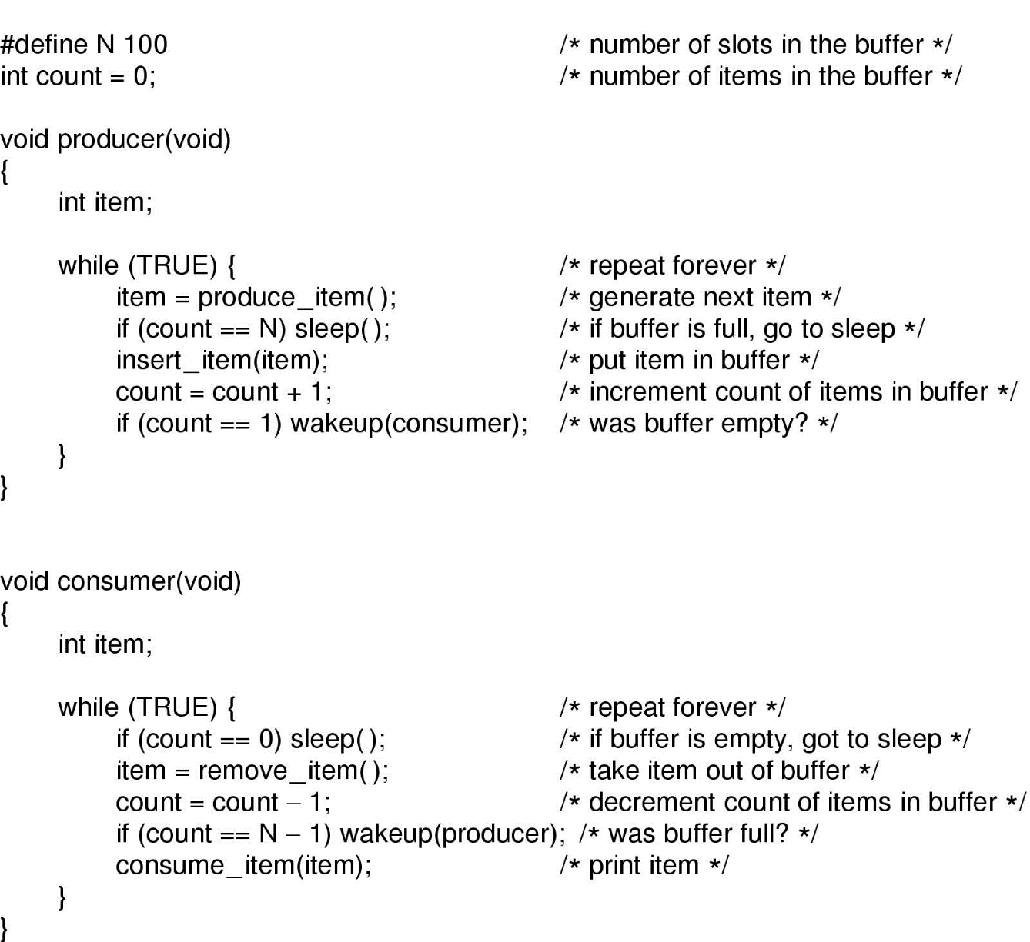
Producer-Consumer Problem
Two processes share a common, fixed-size buffer
  Producer puts info in the buffer. Consumer takes it out.

Slide 5
Problems with Sleep and Wakeup
Race condition can occur with
count: # of items in buffer
Buffer is empty and consumer just reads count
At that instant, scheduler decides to stop consumer temporarily and run producer
Producer inserts an item in the buffer. With count =1, it tries to wake consumer up
The wake up signal is lost since consumer is not asleep
When consumer next runs, it sees count = 0 and falls asleep
Eventually, the producer will fill up the buffer and fall asleep
Both processes will sleep forever

Slide 6
Semaphores
Need a facility to remember the pending wakeup and applies it to a sleep
A new variable type,semaphore, is used to count the number of wakeups for future use
2 operations:
  down(P) : Check count. If count is positive, decrement it and return. If count is 0, put this process to sleep. Checking the value, changing it and going to sleep is done in one atomic action
  up(V): increments count and wakes up a waiter. Incrementing and waking up the process is done in one atomic action
semaphores are used in both user and kernel modes

Slide 7
Semaphore Example
int sem = createsem(2);
down(sem); /*sem count goes from 2->1 */ down(sem); /*sem count goes from 1->0 */
down(sem); /*this thread waits forever */

Slide 8
Create a MUTEX from a Semaphore
Use a binary semaphore(0 or 1)
/* initial count of 1 means one process
is allowed to run in the critical code */
int mutex = createsem(1);
void enter_region(int mutex)
{
down(mutex);
}
void leave_region(int mutex)
{
up(mutex);
}

Slide 9
Semaphore APIs
POSIX-compliant prototypes are defined in /sys/semaphore.h
  sem_init(…) - create semaphore with init count
  sem_wait(…)- same as down
  sem_post(…)- same as up
  sem_destroy(…)- remove semaphore
  …
Non-POSIX compliant prototypes are defined in /sys/synch.h: sema_init(…) etc.
Use “man” for find more details on APIs

Slide 10
Solving Producer-Consumer Problem
Data pipeline similar to MacDonald’s burger pipeline
Don’t want to spin- waste CPU cycles
For a bounded data buffer(i.e. buffer with fixed number of slots):
  Consumer: use a semaphore to keep track of number of objects in the data buffer.
  Buffer empty, consumer waits.
  Producer: use a semaphore to keep track of the number of spaces in the buffer.
  Buffer full, producer waits.

Slide 11
Producer-consumer program
/* needs various headers, including <semaphore.h>; need to define N */
sem_t mutex, empty, full; /* struct type sem_t is defined in header */
int main() {
if (sem_init(&mutex, /*process*-local*/ 0, /*init count*/ 1) < 0){
perror("Failed to create semaphore 1"); return 1;
}
if (sem_init(&empty, /*process-local*/ 0, /*init count*/ N) < 0){
perror("Failed to create semaphore 2"); return 1;
}
if (sem_init(&full, /*process-local*/ 0, /*init count*/ 0) < 0){
perror("Failed to create semaphore 3"); return 1;
}
thread_create(producer, ...); thread_create(consumer, ...);
getchar(); /* block main thread */
/* here, could bring down threads and destroy semaphores, but exit will do it for us */
return 0;
}

Slide 12
Producer-consumer program(cont’d)
/* Note: each system call should have its return value tested as show above for sem_init */
/* Producer will run first and produce N items. During this time, consumer will start and consume some */
void producer()
{
int item;
while (TRUE) {
item = produce_item();
sem_wait(&empty); /* claim empty spot */
sem_wait(&mutex);
insert_item(item); /* insert, protected by mutex */
sem_post(&mutex);
sem_post(&full); /* signal filled-in spot */
}
}

Slide 13
Producer-consumer program(cont’d)
void consumer()
{
int item;
while (TRUE) {
sem_wait(&full); /* claim spot in buffer */
sem_wait(&mutex);
item = remove_item(); /* remove, protected by mutex */
sem_post(&mutex);
sem_post(&empty); /* signal empty spot */
consume_item(item);
}
}

Slide 14
Sharing Semaphores Among Threads
For multithreading, no problem since all threads have access to the semaphore
What happens if threads operate on a different process?
  Need to have shared data structures
    store in kernel; access them using system calls
    OS provides ways for sharing data structures; e.g. a shared file

Slide 15
Monitors
Thinks of this as a guard attached to a piece of code, one thread inside and others waiting their turns outside
A language construct (procedures, variables and data structure) to set up mutex protection for its enclosed code and helps with necessary blocking
Processes can call procedures within a monitor, but they cannot directly access the monitor’s internal data from outside
Only 1 process can be active in a monitor at any instant

Slide 16
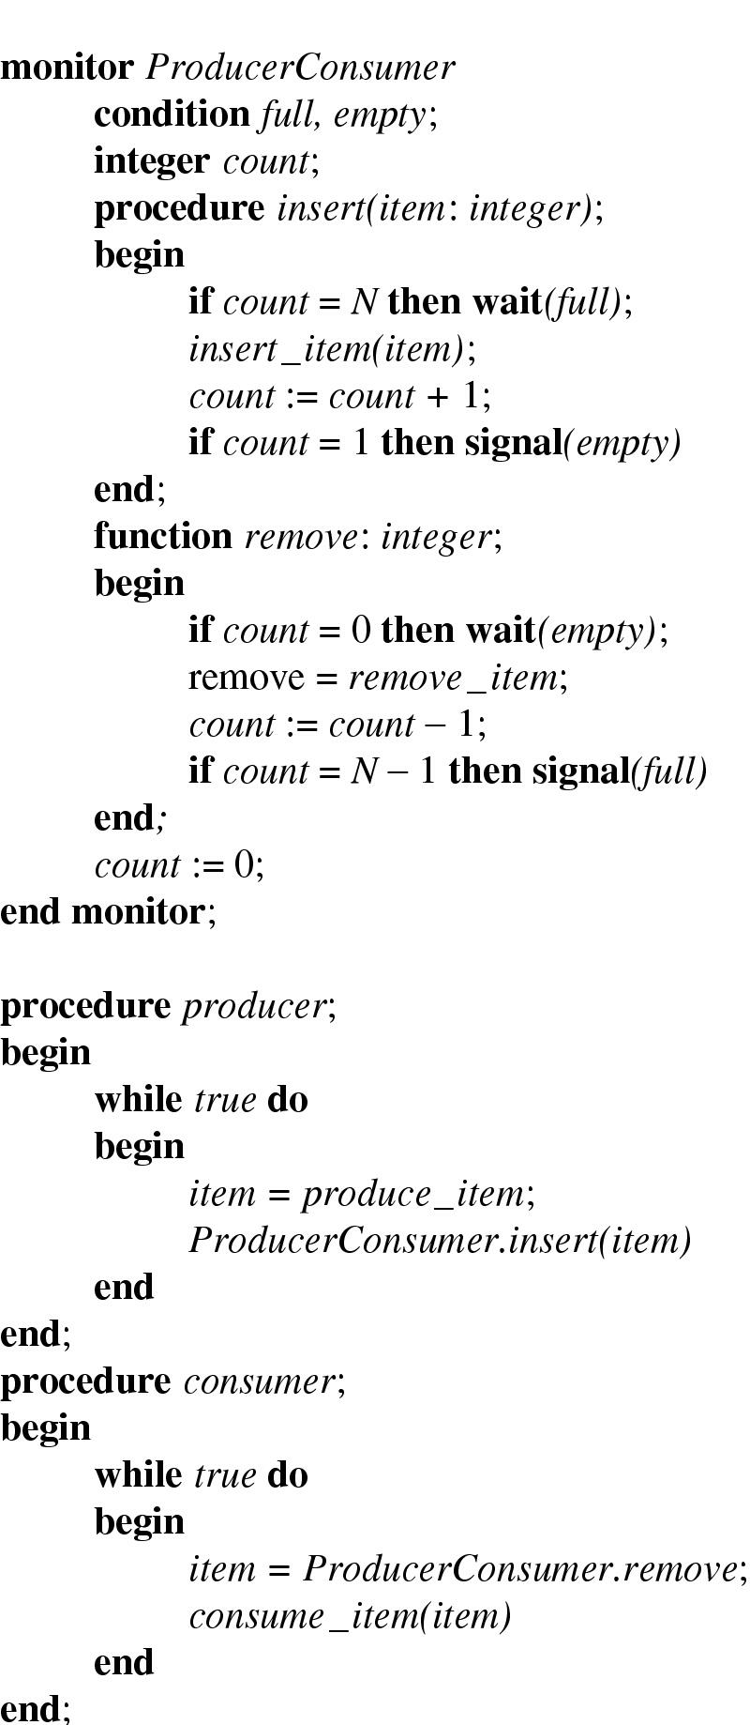
Monitor Example

Slide 17
Blocking Provided by Monitor
Use conditioned variables(e.g. full, empty) and their operations (e.g. wait and signal)
When the monitor cannot continue, it does a wait on some conditioned variable(e.g. full). This causes the calling process to block. Another process can then enter the monitor.
The other process can wake up the blocked one by doing a signal on the conditioned variable (e.g. full)
Need a rule to tell what happens after a signal to prevent 2 processes active in the monitor at the same time

